Slide 1

A Hardware Front-End For Fast Prototyping
By
Cyrill Lippuner
Responsibles:
Prof. Dario Floreano
Matteo Macchini
Olexandr Gudozhnik
Notes:
Hello – Goal to create a Platform for Fast Prototyping – Students – Semester projects – Courses – Learning purposes – Labs – Fast Development
Let‘s have a look at the problem …

Slide 2
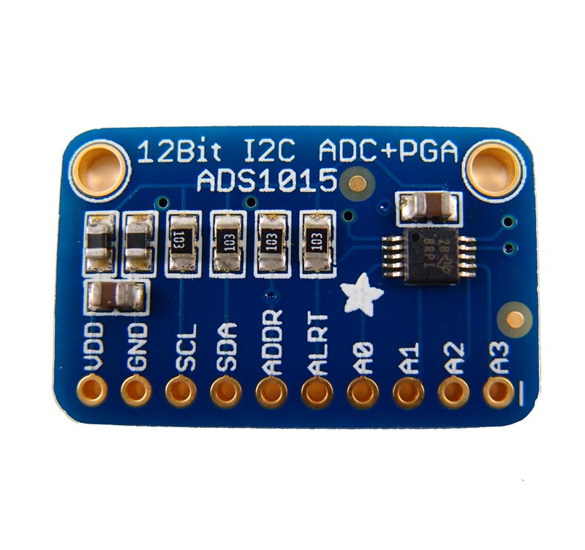
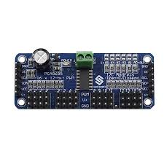

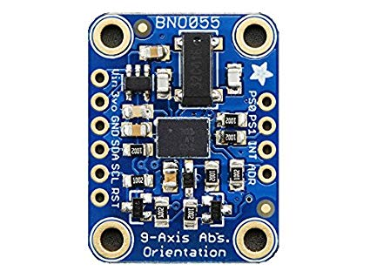
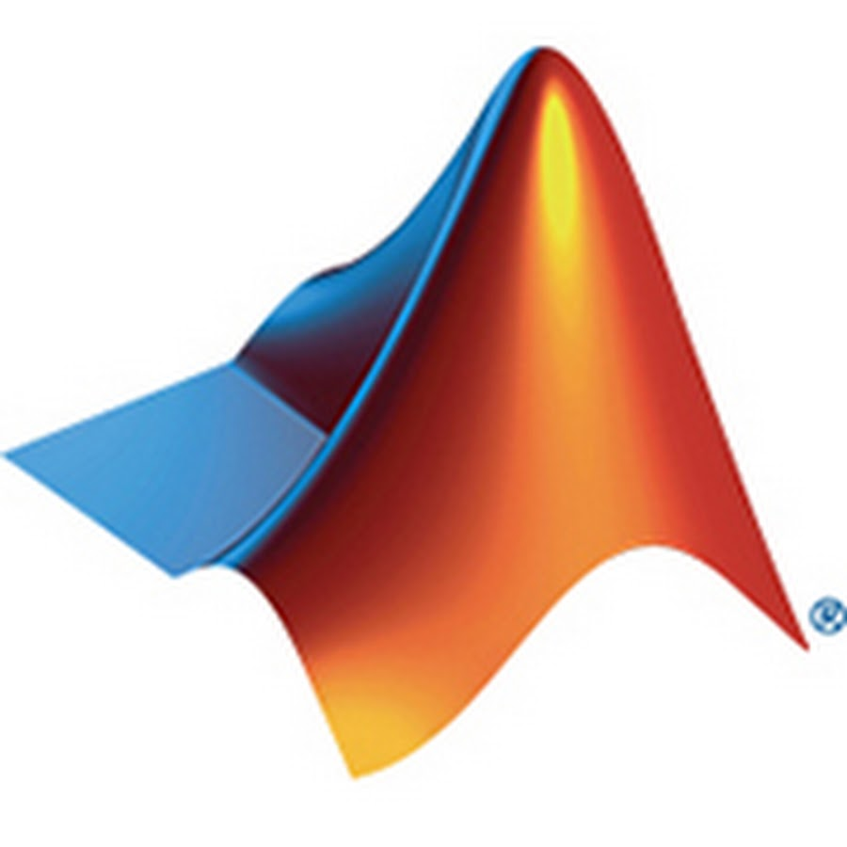
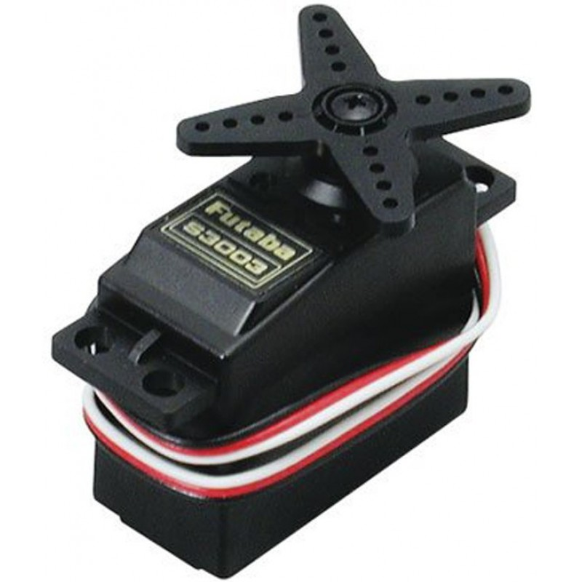

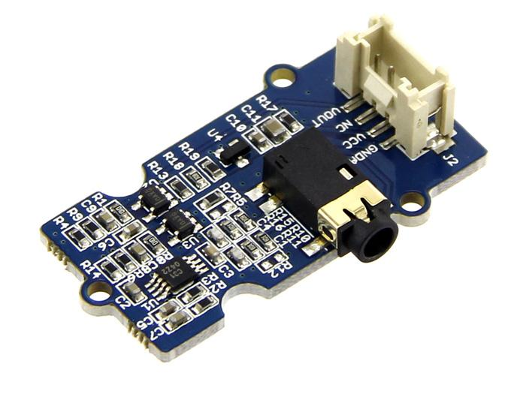
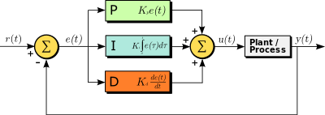
Problem
Analog
PWM
?
IMU
Servo
Closed Loops
EMG
Notes:
As you may already know – large range of sensors – different for each application – connection – software
What is needed – standardized way to connect those
Let‘s talk about existing solutions –

Slide 3
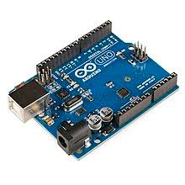

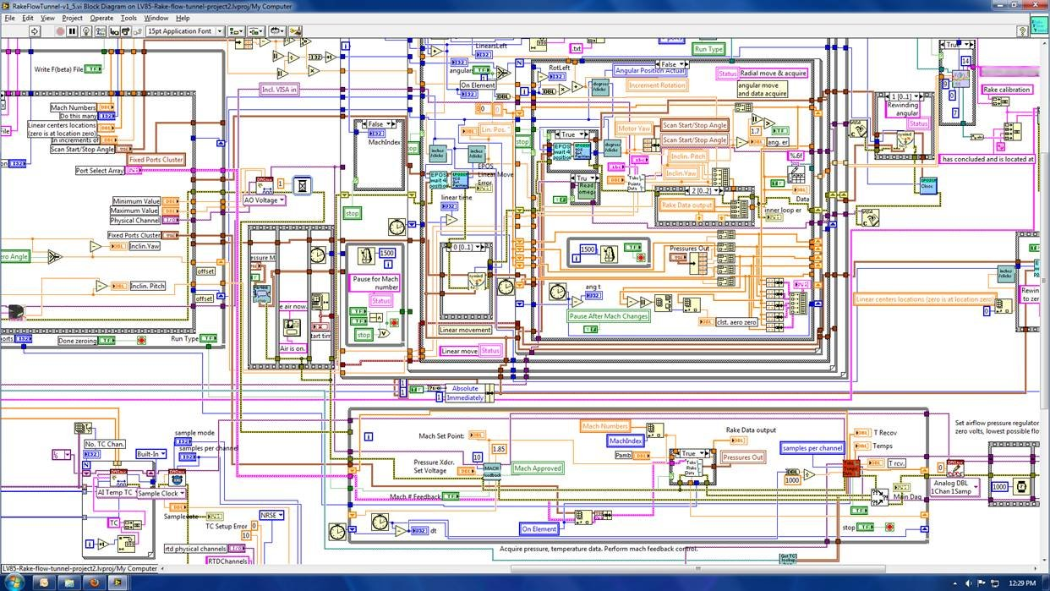
State Of The Art
Arduino
Dedicated drivers are not always available
Hardware/Software limited
Proprietary programming language
No visual interface
No Plug‘n‘Play
ROS
Quite complex
Linux only
No visual interface
No Plug‘n‘Play
LabView
Complex visually programmed based framework
Proprietary sensors
Expensive ($1.325 / licence)
Arduino
LabView
Notes:
Arduino – Wildly used – Low level approach – Can do everything – No prior knowledge – Hard time
ROS – More complex – More possibilities
LabView – Industrial approach – visual programming – high cost
Target group – Researchers and Students with limited programming background

Slide 4
Limitations
?
No Visual Feedback
No Plug‘n‘Play
Not Userfriendly For Beginners
No Programmatic From PC
High Cost For Out-Of-The-Box Solutions
Notes:
Most important aspects – limitations to overcome
No visual feedback for Arduino and ROS
No plug‘n‘play – Mouse or Keyboard
No entry level – deep dive
Microcontroller programming – different rules compared to MATLAB
Dismiss all above with LabView – high cost

Slide 5
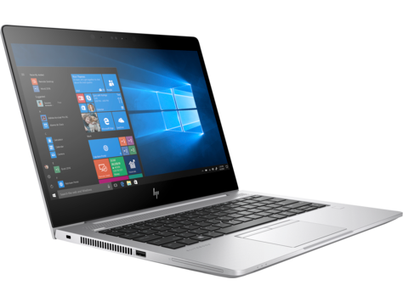
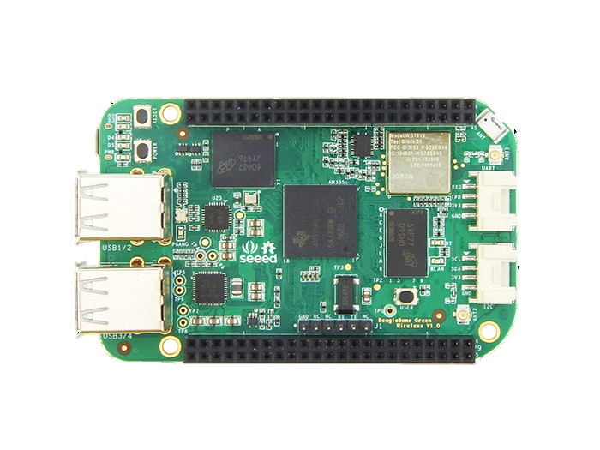
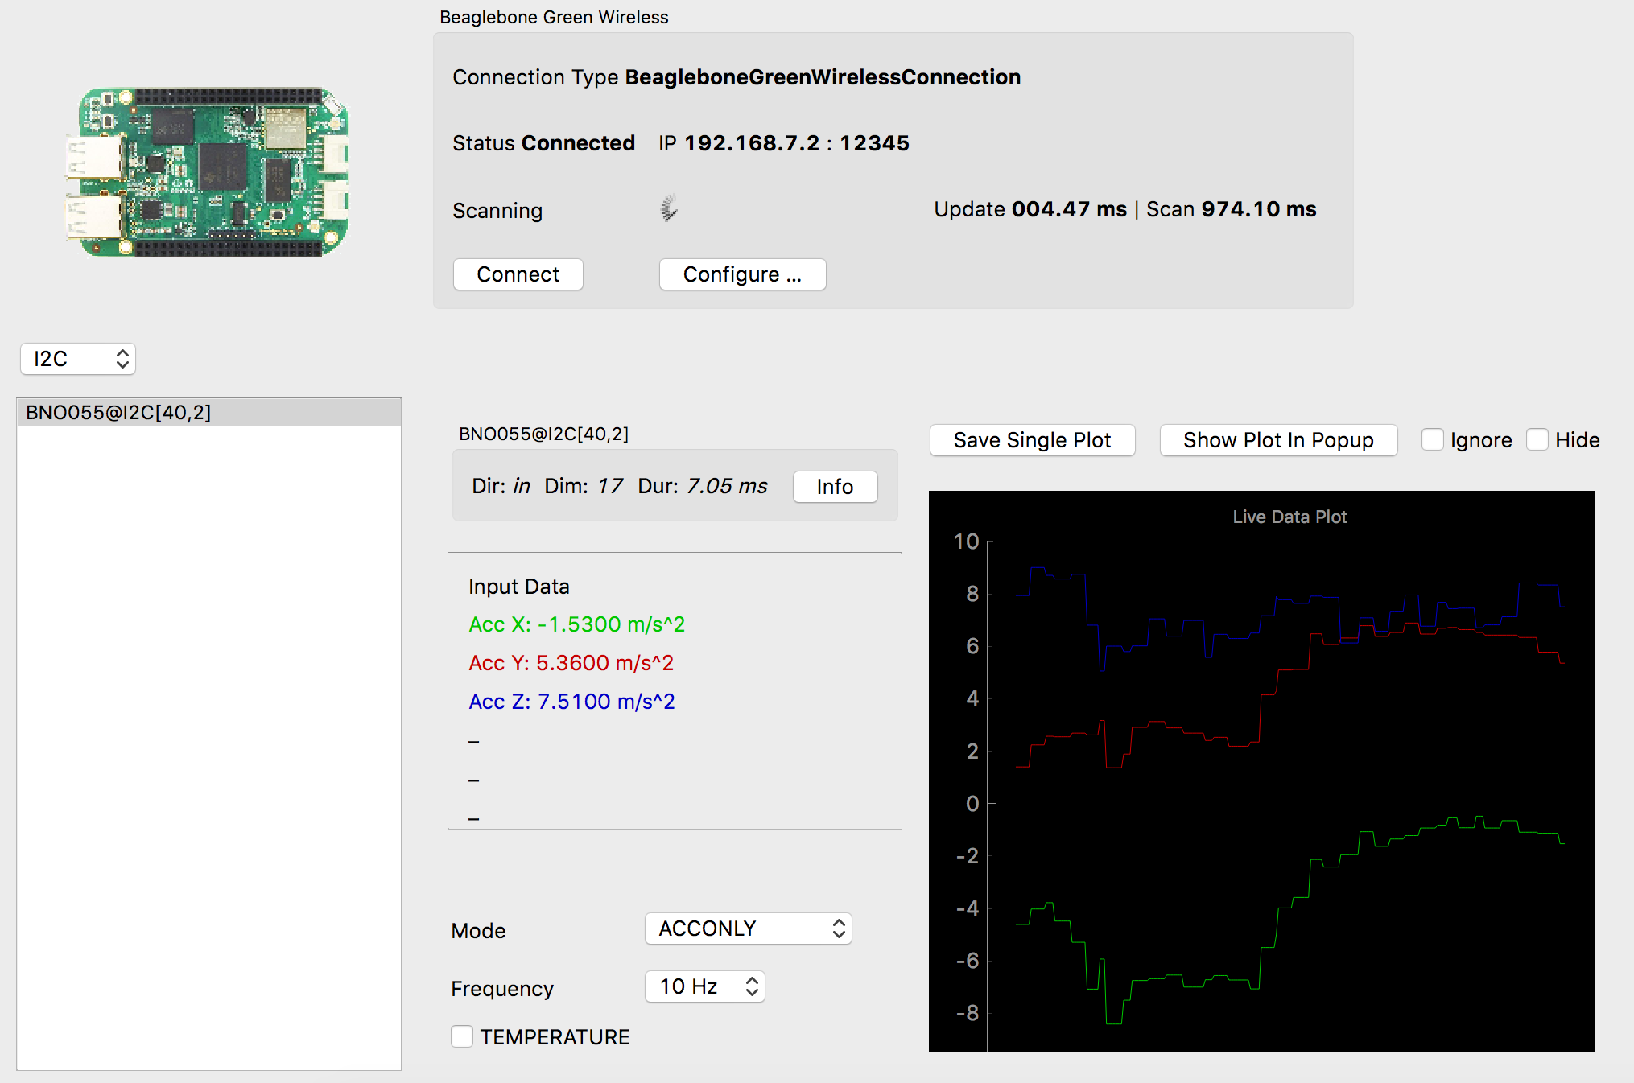
Solution
Analog
PWM
?
Beagle Bone Green Wireless
PC
IMU
Servo
Interface
Closed Loops
EMG
Notes:
About our solution – Consists of hardware and software – Microcontroller and Interface – Create standarized connections without programming effort
From Sensor to BBGW – from BBGW to Interface – from Interface to software

Slide 6


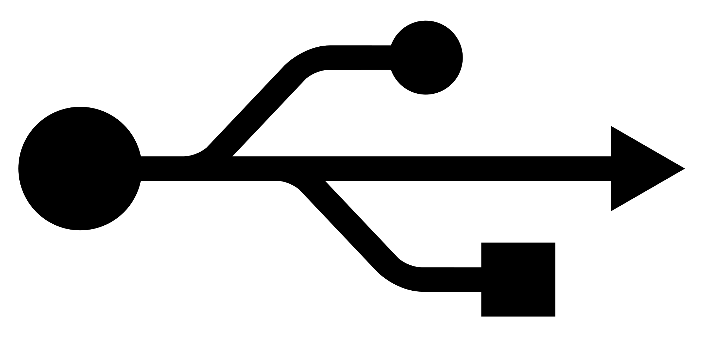
Method
Scripts
I²C
PWM
UDP
Analog
TCP/IP
Write
Framework
Notes:
Our framework takes care – hardware connections – communication – data streams

Slide 7
Demo 1: Demo 2: Demo 3:
Hardware (Devices)
I²C, PWM, ADC, Digital I/O and MUX
Plug‘n‘Play cape layout configuration
Drivers for most commonly used devices
Firmware (BBGW)
Runtime configurations
Modular Driver Functionality
Scanning for Plug‘n‘Play devices
API to interface via TCP/IP socket
Customizable closed loop controllers (online)
Software (PC)
Visual live interface
Individual device plotting and configuration
Data streams to file and UDP
Runtime diagnosis
Diverse multiplots
API class to use for third-party applications
Customizable closed loop controllers (offline)
I²C
PWM
UDP
Analog
TCP/IP
Write
Framework
Framework
Notes:
Demos Increase with complexity

Slide 8
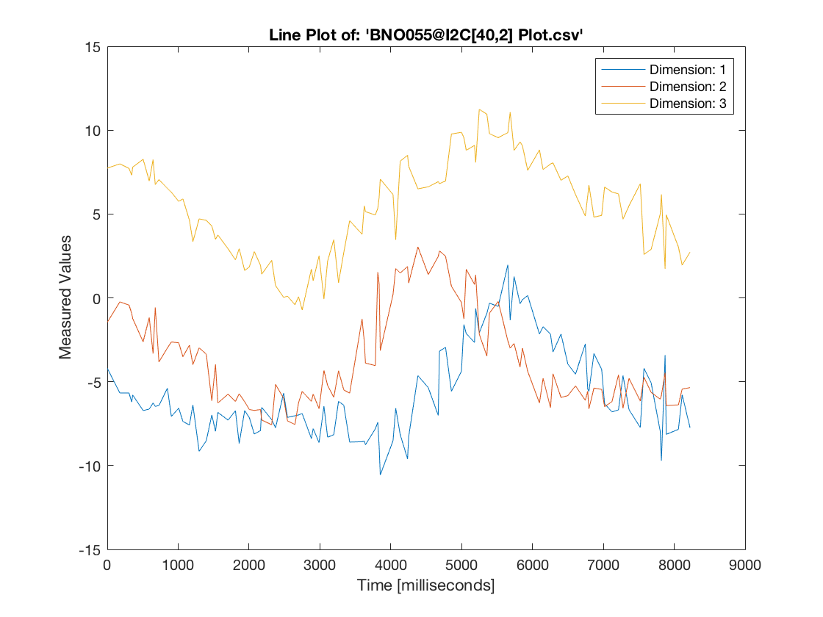
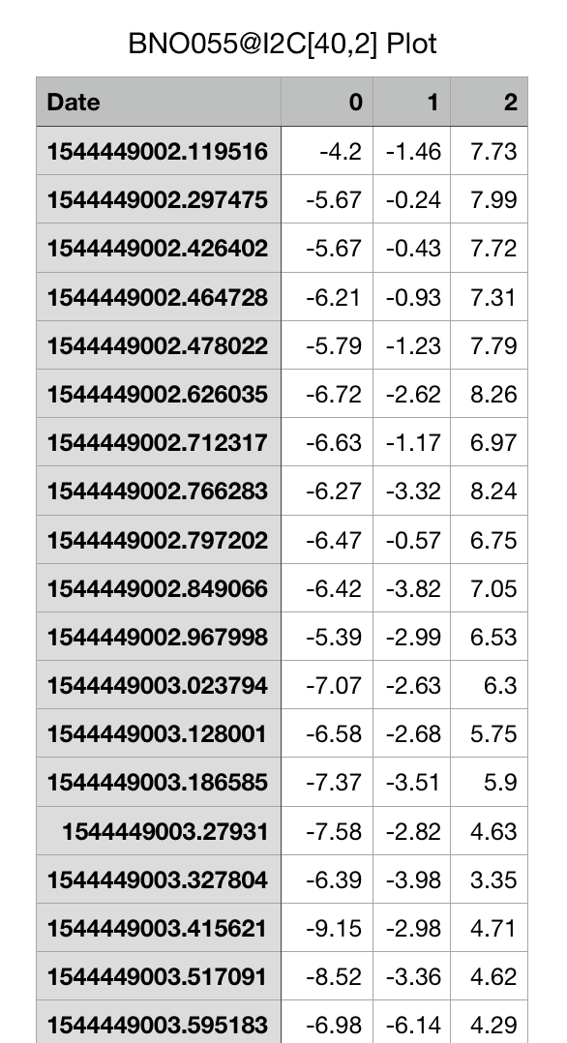
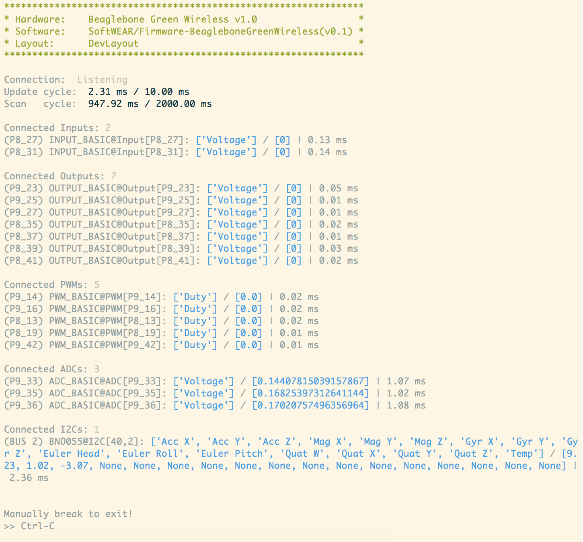
Demo 1 – Data Acquisition, Visualization and Streaming
IMU
I²C
UDP Stream
TCP/IP
File Stream
BBGW
Interface

Slide 9
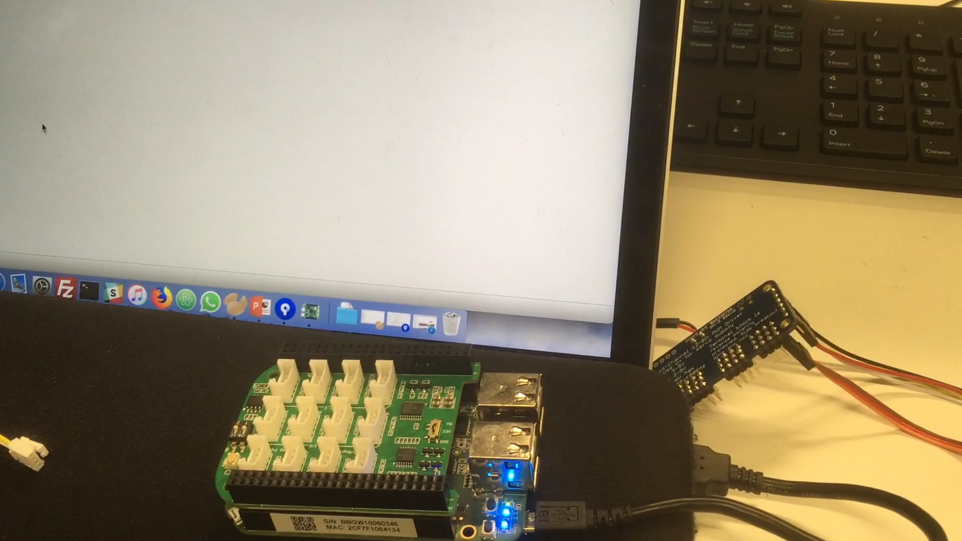

Slide 10
Demo 1: Demo 2: Demo 3:
Hardware (Devices)
I²C, PWM, ADC, Digital I/O and MUX
Plug‘n‘Play cape layout configuration
Drivers for most commonly used devices
Firmware (BBGW)
Runtime configurations
Modular Driver Functionality
Scanning for Plug‘n‘Play devices
API to interface via TCP/IP socket
Customizable closed loop controllers (online)
Software (PC)
Visual live interface
Individual device plotting and configuration
Data streams to file and UDP
Runtime diagnosis
Diverse multiplots
API class to use for third-party applications
Customizable closed loop controllers (offline)
I²C
PWM
UDP
Analog
TCP/IP
Write
Framework
Framework

Slide 11
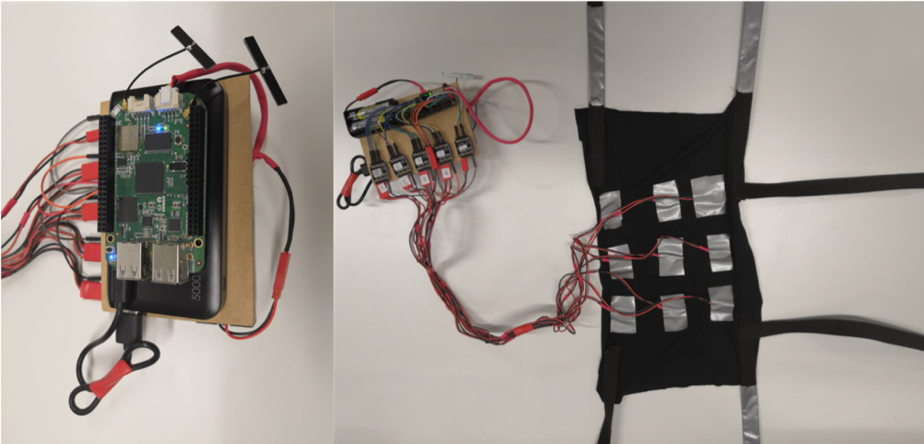


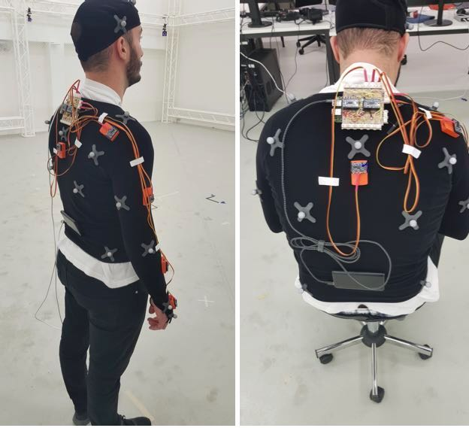
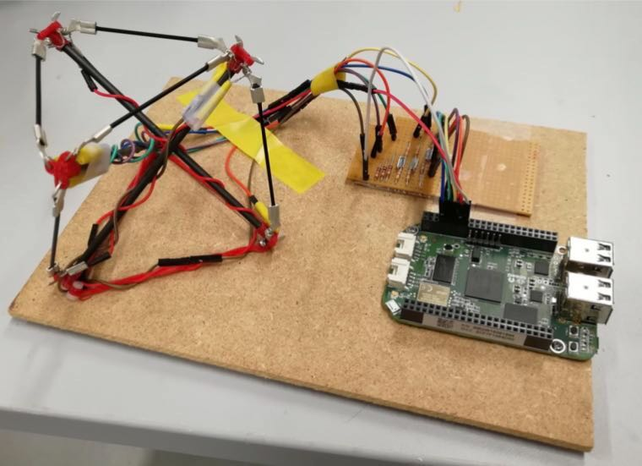
Demo 2 – Plug‘n‘Play
Hugo Kohli
TCP/IP
Victor Faraut
9 Vibration Motors
I²C 16-Channel PWM Bridge
API Integration
6 Analog Inputs
On-Board ADC
Live Feedback
9 IMUs
2 I²C 8-Channel Multiplexer
Data Streaming
Siqi Zheng

Slide 12
Demo 1: Demo 2: Demo 3:
Hardware (Devices)
I²C, PWM, ADC, Digital I/O and MUX
Plug‘n‘Play cape layout configuration
Drivers for most commonly used devices
Firmware (BBGW)
Runtime configurations
Modular Driver Functionality
Scanning for Plug‘n‘Play devices
API to interface via TCP/IP socket
Customizable closed loop controllers (online)
Software (PC)
Visual live interface
Individual device plotting and configuration
Data streams to file and UDP
Runtime diagnosis
Diverse multiplots
API class to use for third-party applications
Customizable closed loop controllers (offline)
I²C
PWM
UDP
Analog
TCP/IP
Write
Framework
Framework

Slide 13
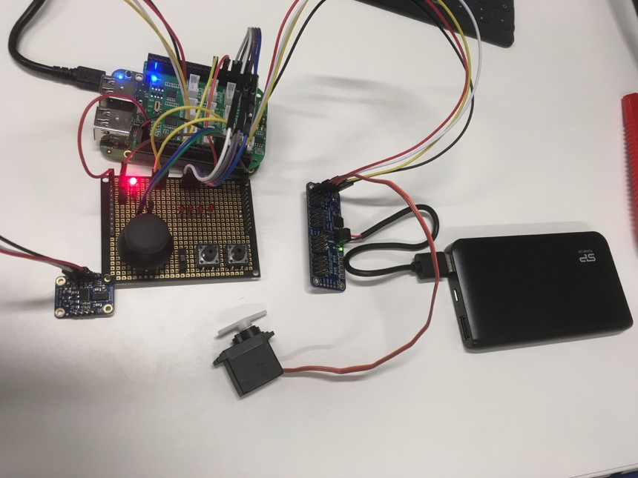
Demo 3 – Embedded Scripting (Online / Offline Closed Loops)
Hugo Kohli
TCP/IP
API
Commanding an array of vibrating motors with a PWM multiplexer connected to a BBGW with the Firmware through the API.
Closed Loops
Connecting a Joystick to some LEDs (39 Lines)
Connecting an IMU to an Servo (6 Lines)

Slide 14
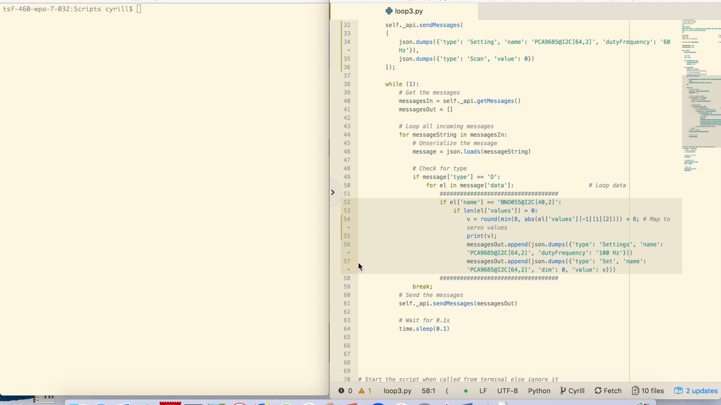

Slide 15
Conclusion
?
Hardware Front-End Framework
New Features
Visual Interface
Plug‘n‘Play
Easy Usage
Overcome Limitations
No Firmware Development Required
Low Complexity For Prototyping
No High Costs
Can be used across a large range of applications (Demos):
Data Aquisition
Servo and Motor Control
Online / Offline Closed Loop Control

Slide 16
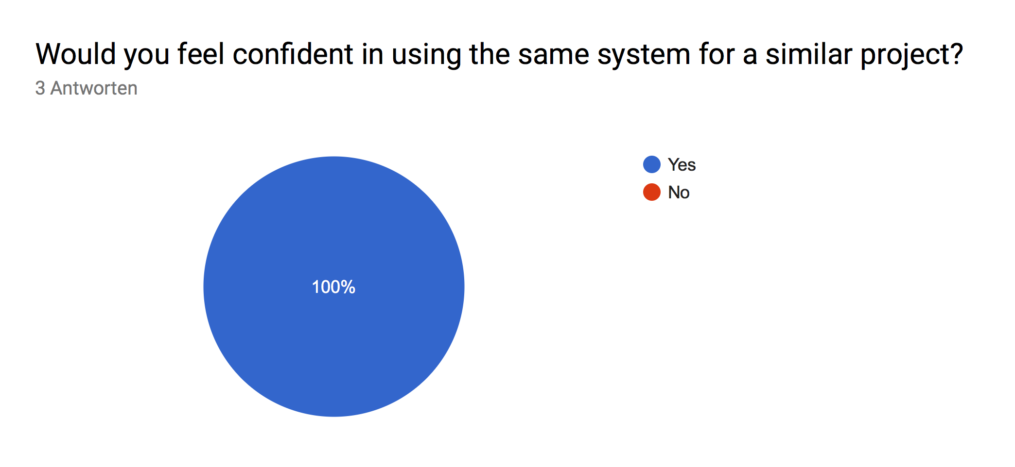
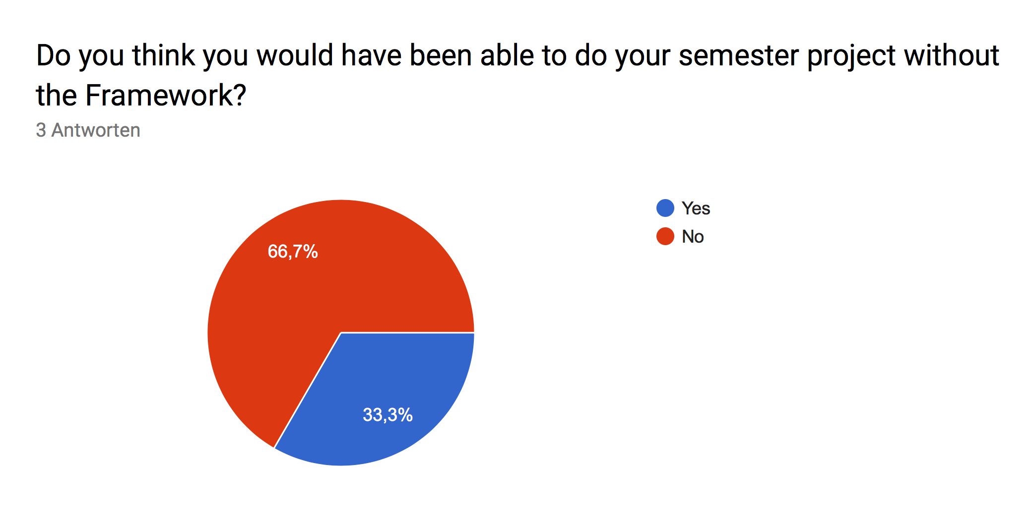
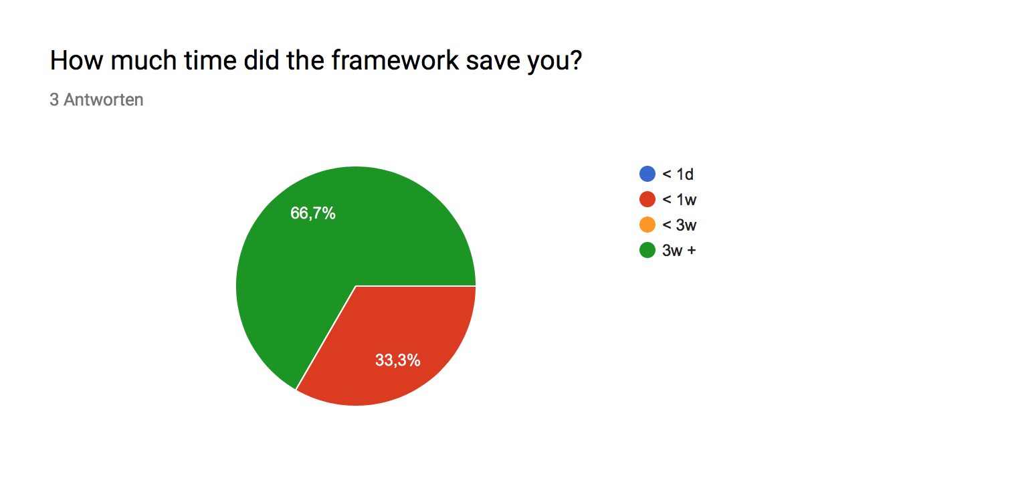
Evaluation
Notes:
Evaluate the performance and usability – Would use again – Not able to do it without – Time saving up to 3 weeks
Great success

Slide 17
Future Work
Driver Installer and Custom Scanning
Embedded Scripting
SPI & UART
C / C++
Notes:
Some comments

Slide 18
Thank You For Your Attention!

Slide 19
Appendix

Slide 20
Future Work
Driver Installer and Custom Scanning
Extend driver functionality with installer to manage a large set of drivers by optimizing the scanning using custom scanning configuration.
Embedded Scripting
To improve embedded scripting handling, replace the bash script with an integrated uploader in the Interface.
SPI & UART
Only I²C protocol (and basic I/O) has been implemented. SPI and UART are yet to be done.
C / C++
Programming in Python always comes with the downside in terms of real-time performance. To improve real-time precision, a transition to C/C++ for the Firmware is necessary.
Notes:
Some comments

